Slide 1
Lab meeting
Studying the translational interaction between an
EV-A71 virus and its host cell
Shawn Lee
30th January 2019

Slide 2
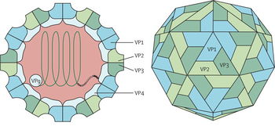
Significance of Enterovirus-A71 (EV-A71)
Picornaviridae family (incl. Poliovirus)
Non-enveloped , positive sense ssRNA virus
7.4kb in length
Internal ribosome entry site (IRES) mediated translation
Along with Coxsackievirus (CV), EV-A71 is one of the main cause of Hand, Foot and Mouth Disease (HFMD)
Can cause complications with the nervous system and the heart
Notes:
In Taiwan (1998), about 1 in 3,800 neurological complications
In China (2008-2012), about 1 in 3000 deaths

Slide 3
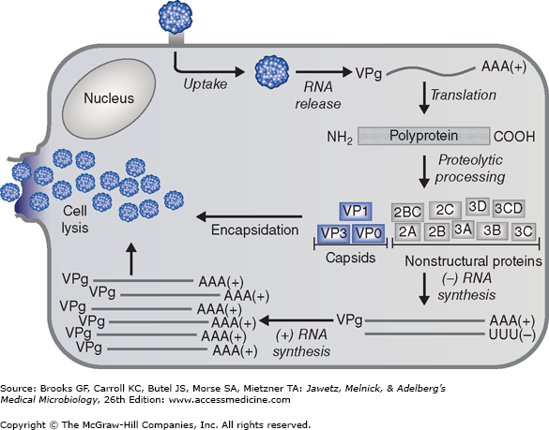
Summary of EV-A71 life cycle
Clathrin-mediated endocytosis
Sequence of events:
Entry
Translation
(switch!)
RNA synthesis
Cell lysis/ Exit

Slide 4
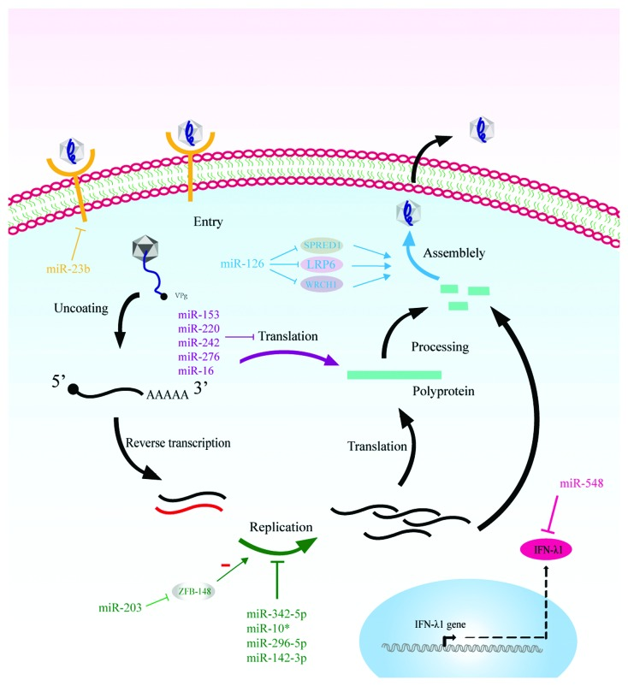
Notes:
“Cellular microRNAs and Picornaviral Infections” (2014)

Slide 5
Project outline
Aim: To identify changes in translatome during infection of an EV-A71 infected cells
-> Host Factors that are regulated in viral translation may be important for establishing the viral infection
General Idea
Infect cells at various timepoints
Collect lysates post infection (cold sync-ed)
> 1hpi, 6hpi, 9hpi
> 0 hours mock, 0hpi, 2hpi, 4hpi, 6hpi, 8hpi x2
> Sequence both RNAseq and RPF
Perform analysis to identify relevant genes
Validate changes of genes
Test for functions of genes in viral infection

Slide 6
Experimental Update
Library generation for biological replicate
RPF
10bp
26+32 pcp
10bp
10bp
26+32 pcp
10bp
0m
0i
2i
4i
6i
8i
NTC
0m
0i
2i
4i
6i
8i
NTC

Slide 7
Experimental Update
Library generation for biological replicate
RNAseq
32 +47 pcp
32 +47 pcp
10bp
10bp
0m
2i
4i
6i
8i
10bp
NTC
10bp
0m
0i
2i
4i
6i
8i
NTC
0i

Slide 8
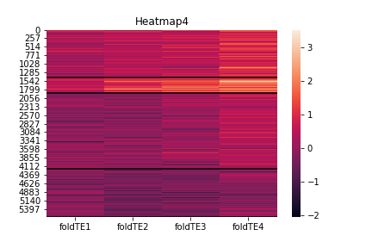
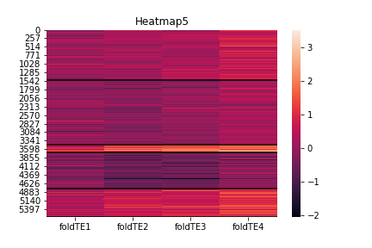
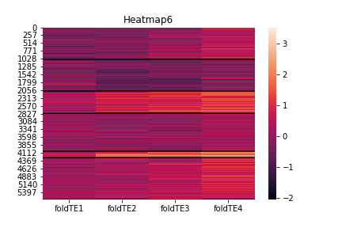
Results of heat maps after clustering (0.5)
RNA within log2FC of -0.5 to 0.5, compared to 0i
2i
4i
6i
8i
2i
4i
6i
8i
2i
4i
6i
8i
GO terms from cluster
Regulation of small GTPase mediated signal transduction
Positive regulation of GTPase activity
Negative regulation of transcription from RNA pol II promoter
Positive regulation of GTPase activity
Establishment of cell polairty
Signal transduction
Positive regulation of GTPase activity
Establishment of cell polairty
Smoothened signaling pathway
Common terms in top10 also includes Signal transduction
Clustering by kmeans, done by Dash
Notes:
Across all the timepoints, log2FC for (2i/0i, 4i/0i, etc) on RNA level remains constant within this range, but TE level changes.

Slide 9
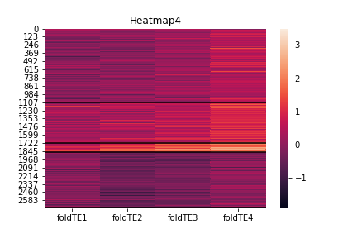
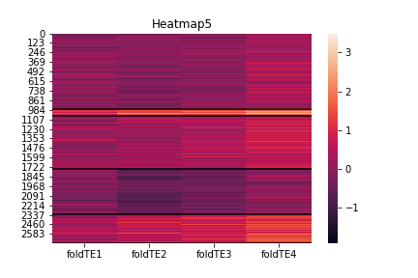
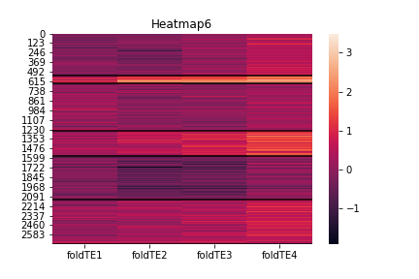
Results of heat maps after clustering (0.3)
RNA within log2FC of -0.3 to 0.3, compared to 0i
GO terms from cluster
Positive regulation of GTPase activity
Regulation of vesicle fusion
Activation of GTPase activity
Positive regulation of GTPase activity
Positive regulation of transcription, DNA templated
Positive regulation of dendrite development
Positive regulation of GTPase activity
Positive regulation of dendrite development
Positive regulation of transcription, DNA-templated
Common terms in top10 also includes
Signal transduction
Positive regulation of transcription, DNA-templated
Clustering by kmeans, done by Dash

Slide 10
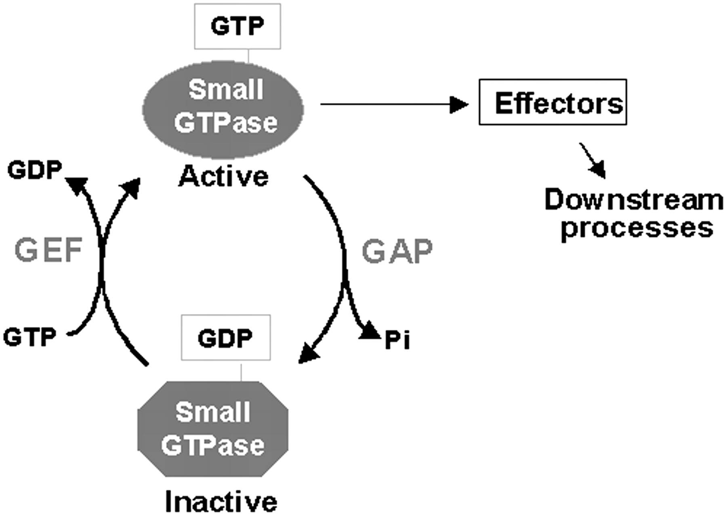
GTPases: what are known?
GTPases: Enzymes that binds and hydrolyzes GTP;
Includes Heterotrimeric G proteins (activated by GPCRs) and small GTPases, a.k.a. small G proteins e.g. RHO-GTPase
Involves various proteins including GAPs and GEFs, as well as GDI
Under the Ras superfamily,
Consists of different families, including Ras, Rho, Ran, Rab and Arf
Each have different functions
- Differences for products at the subfamily/ family level
Notes:
Also, Structure-activity relationship study of itraconazole, a broad-range inhibitor
of picornavirus replication that targets oxysterol-binding protein (OSBP)
Superfamily: Ras
Family: Rho, Ras, Ran, Rab, Arf
Subfamily: RhoA, RhoD, Rac, Cdc42
Generally: Ras – cell proliferation
Rho – Morphology
Ran – Nuclear transport
Rab/Arf – Vesicle transport
GDI: Guanosine Dissociation inhibitor, prevents GAP activity

Slide 11
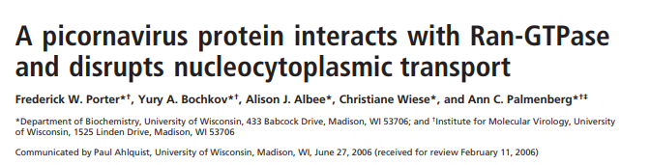
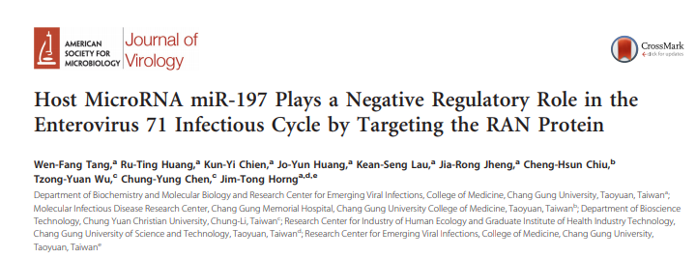
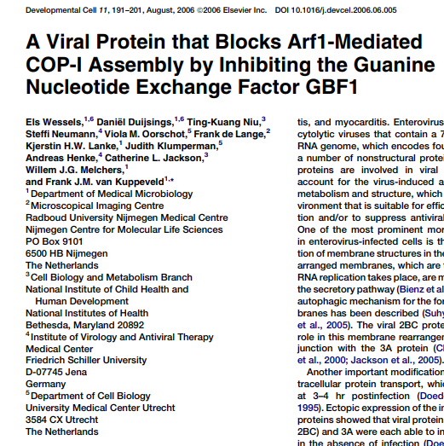
GTPases: what are known?
Examples of interactions with picornaviruses
- Interacts via L protein (cardiovirus)
- miR-197 influences EV71 infection, via RAN (Small GTPase), which affects nuclear transport
Inhibits activation of Arf1 (Coxsackievirus B3)
Affects protein transport
Notes:
RAN= Ras related nuclear protein
RAN affects nuclear transport of both viral (and nuclear proteins (hnRNPK)

Slide 12
Hypothesis
A certain class/member of GTPase is important for establishing the infection
Majority linked to Rho GTPases, although some Arf also seen
Focusing on the translation level change
Distinct from Ran
Protein levels reported to be stable; half life of 7hours
Increasing percentage of RAN translated (?)
Notes:
Rho GTPase: 6 GAPs, 2 GEFs

Slide 13
Relevant experiments for GTPases
Checking for changes in GTPase activity through infection
Rho GTPase (subfamily level) specific
For GTPase member-specific activity, do targeted studies to check for specificity of GAP/GEF
Inhibiting specific GTPases to check effect during infection
Specific Rho drugs e.g. Rhosin or C3 transferase against RhoA/B/C, but not cdc42/Rac1
Specific cdc42 drugs e.g. Casin, ML141
Specific Rho kinase inhibitors e.g. Rhodblock series
Notes:
https://www.ncbi.nlm.nih.gov/pmc/articles/PMC4710138/ -> GAP determination of specificity (Check colocalisation)
Ran GTPase: https://www.cellbiolabs.com/sites/default/files/STA-409-ran-activation-assay.pdf (Not available on Thermo)

Slide 14
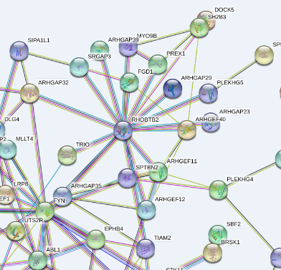
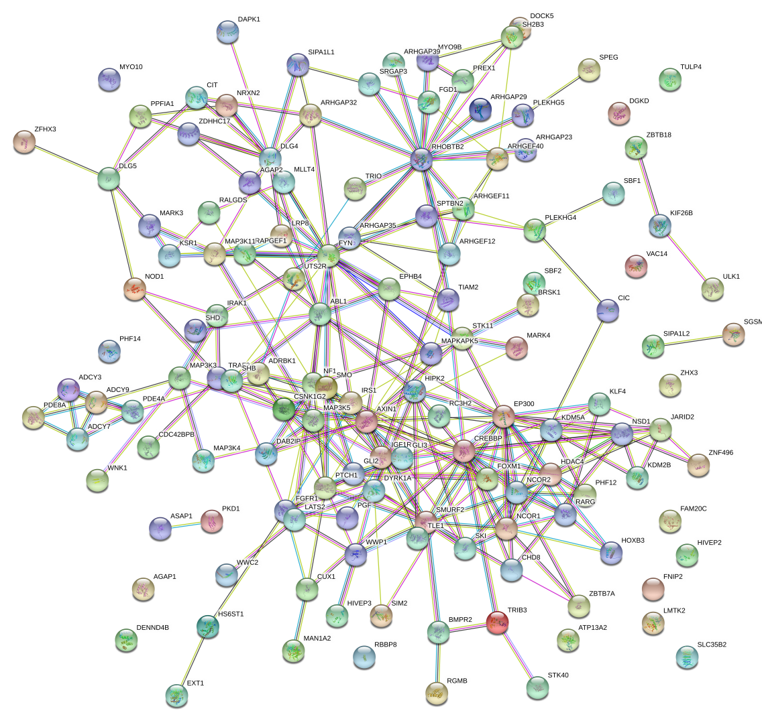
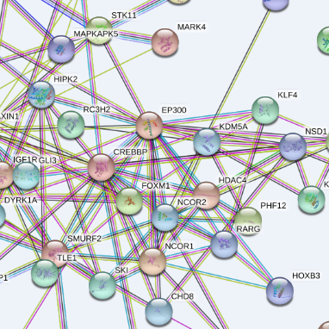
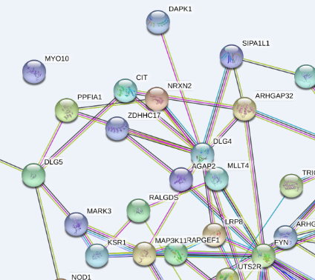
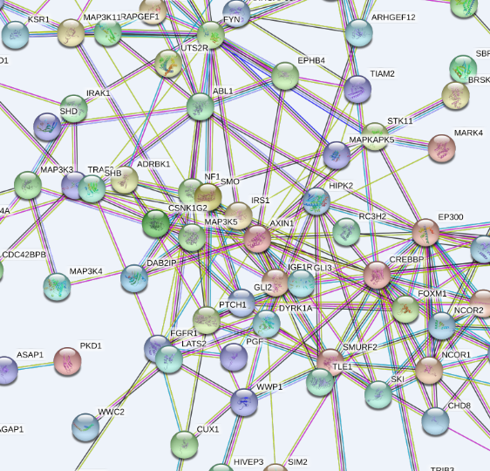
Analysis of GO terms for genes in cluster
CREBBP, EP300, GLI2 and Axin1 are common in all 3 groups of different number of clusters.

Slide 15
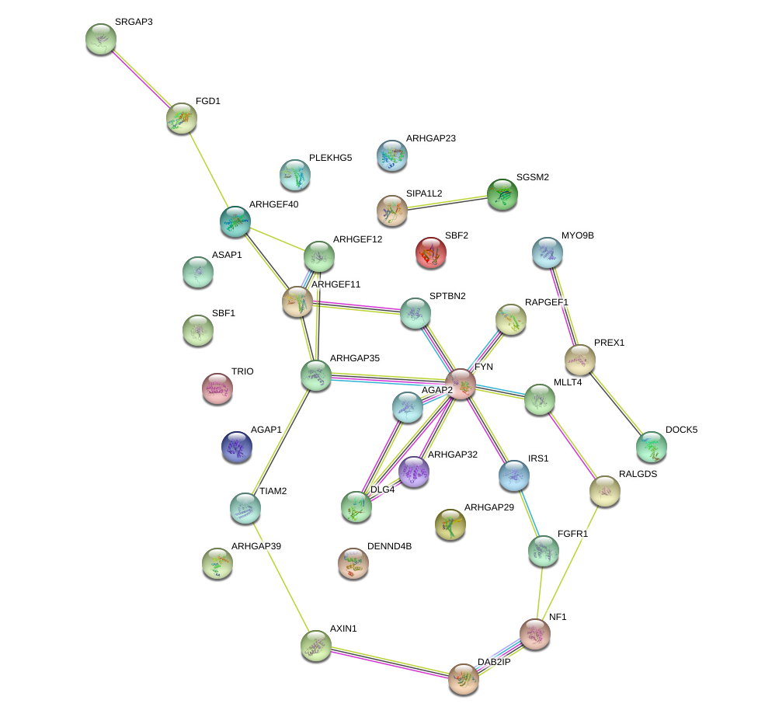
Analysis of GO terms for genes in cluster - GTPase
-0.5 to 0.5;
4 clusters
Notes:
FYN – Tyrosine kinase

Slide 16
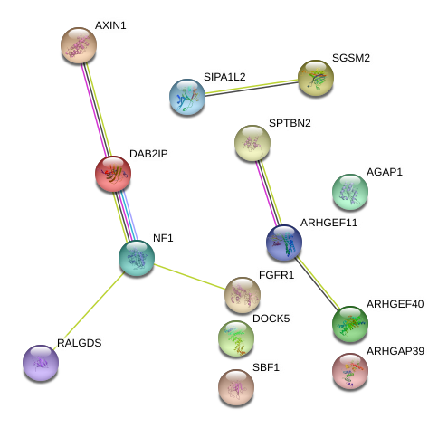
Analysis of GO terms for genes in cluster - GTPase
-0.3 to 0.3;
4 clusters

Slide 17
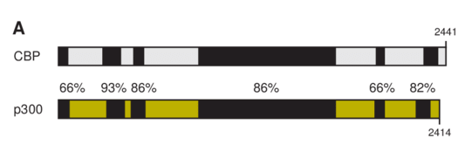
Relevant details about CREBBP (CBP)
and EP300 (p300)
Transactivation domain
Acetyl-transferase
Transactivation domain
Transcriptional co-activator of TFs
Histone acetyltransferases
CREBBP/P300 has a role in NF-kB activated transcription (growth and immune-related)
CREBBP is reported to be important for replication in CVB and PV infected cells in HBMEC cells (based on siRNA knockdown)
Notes:
Comparative RNAi screening reveals host factors involved in enteroviruses infection of polarized endothelial monolayers

Slide 18
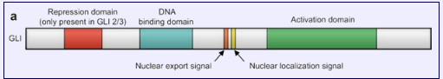
Relevant details about GLI2
Transcription factors that bind DNA via zinc finger motifs (incl. HH pathway)
Gli2 can promote proliferation and migration via transcriptional activation of ARHGEF
No clear information on its use in picornavirus/EVA71
Notes:
GLI2 promotes cell proliferation and migration through transcriptional activation of ARHGEF16 in human glioma cells

Slide 19
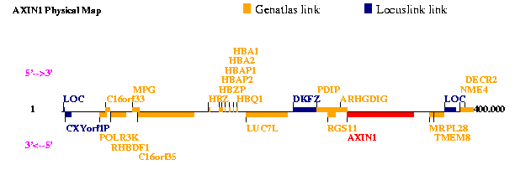
Relevant details about Axin1
Contains a Regulator of G protein signaling (RGS) domain, which inactivates heterotrimeric GTPases, switching off GPCR signaling pathways
Involved in Wnt signaling; Destruction complex for β-catenin via proteasome upon ubiquitination
No clear information on its function in picornavirus/EVA71, no known link to small GTPase

Slide 20
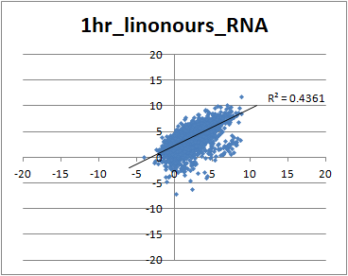
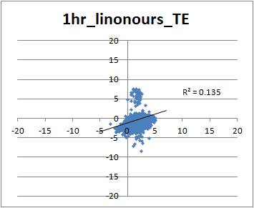
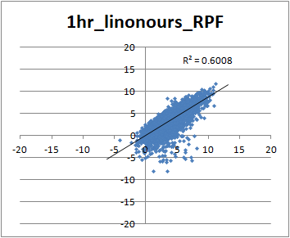
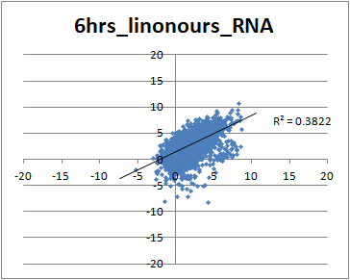
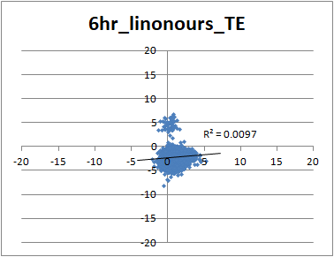
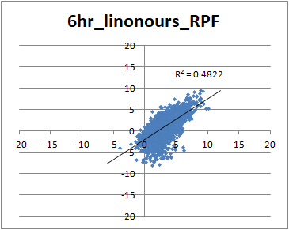
Comparing ours and Lin’s data
- Did infection using high MOI to synchronize infection
- 3 timepoints: 1.75hpi, 3.5hpi and 6.25hpi

Slide 21
Ongoing work
Designing experiments to verify the need for GTPase in infection – Rho GTPase
Inhibiting the activity of GTPase and observing its effects: Small molecules that are done with 24hour incubations…
Literature review of link between miRNAs, small GTPases and picornavirus infection
From Ran scenario, where miRNA controls its activity

